Slide 1

UNDER GUIDANCE OF
Dr. ASHANT RANJAN ROUTRAY
Co- GUIDANCE OF
Mr. ASHIS KUMAR PRADHAN, FMU
ONLINE GRADESHEET GENERATION
SUBMITTED BY : -
JAGANNATH GHADIA
ROLL NO : - 15101FT176012
&
CHANDAN BEHERA
ROLL NO : - 15101FT176004

Slide 2
ABSTRACT
The Project is aimed at developing an “ONLINE GRADESHEET GENERATION” providing to the examination section for quick result management for the student. As examination section handle a busy schedule for the huge number of student at Fakir Mohan University. So the system help them to get result in less time. The system fully organised and used by Directorate of Distance and Continuing Education, Fakir Mohan University, Balasore.

Slide 3
OBJECTIVE
To manage students information during examination.
To reduce unnecessary paper work in maintaining students information.
Information about subjects offered in various semesters.
Generation of the reports, result and gradesheet of the students.

Slide 4
PROPOSED SYSTEM
We have successfully proposed the “ONLINE GRADESHEET GENERATION” for replacing the manual work of the administration.
By this application admin can easily access the students gradesheet.
This application is flexible and can easily access by the admin .
So the time taken for getting the information will be reduces.

Slide 5
SYSTEM REQUIREMENT
Hardware Requirement
    CPU: Single Core 2.4 GHZ
    RAM: 4GB
    Graphics Card: Intel or Nvidia
    Hard Drive: 1TB
    Processor: Core i3
Software Requirement
    Front-End Design : HTML , CSS, JS, Bootstrap
    Back-End Database : MYSQL Server, PHP , Apache Web Server

Slide 6
Tools And Platform
We have used PHP , HTML, CSS and JavaScript for making this website.
For saving the data of students we have used mysql database.
The entire website executes on the WAMP server.
To Access the website we can use any type of web browser.

Slide 7
FLOW OF THE PROJECT
STEP-1
  Making SRS
STEP-2
  Coding and developments
  Coding for Web page design
  Coding for Database design
  Connectivity of database
STEP-3 Testing
  Functionality Testing
  Usability Testing
  Interface Testing
  Performance Testing
STEP-4
  Implementation and Maintenance

Slide 8
PROJECT DESCRIPTION
Admin Create and manage the subjects , add the students, input marks and results of the students.
Development of a software that displays results of the students and generation of gradesheet to the students.

Slide 9
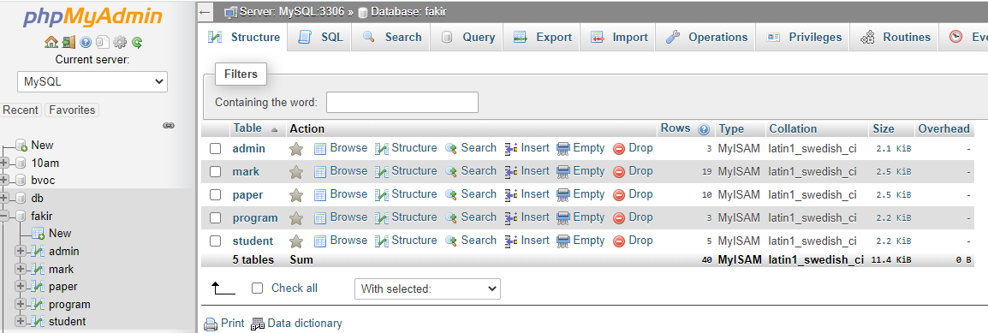
DATABASE(FAKIR)

Slide 10
DATABASE DESIGN
Table-: admin
Field Name | Data Type | Description
Uid | Int(4) | primary
Uname | Varchar(50) | ----
Pwd | Varchar(20) | -----
Table-: student
Field Name | Data Type
studname | Varchar(50)
dob | date
Gender | varchar(10)
Regdno | Varchar(10)
Rollno | Varchar(15)
Prgmcode | Varchar(6)
Session | Varchar(4)
Table-: program
Field Name | Data Type
Prgmcode | Varchar(50)
Prgmname | Varchar(100)
Nosem | Int(2)
Nopap | Int(2)
Fm | Int(11)

Slide 11
Database Design
Table-: paper
Field Name | Data Type
Prgmcode | Varchar(10)
Sem | Varchar(10)
Papcode | Varchar(5)
Papname | varchar(50)
Intfm | int(3)
Semfm | int(3)
Totmark | int(3)
Intpm | int(3)
Sempm | int(2)
Cp | Int(2)
Table-: mark
Field Name | Data Type
Rollno | Varchar(15)
Papcode | Varchar(20)
Session | int(4)
intsecmark | int(2)
semsecmark | Int(2)

Slide 12
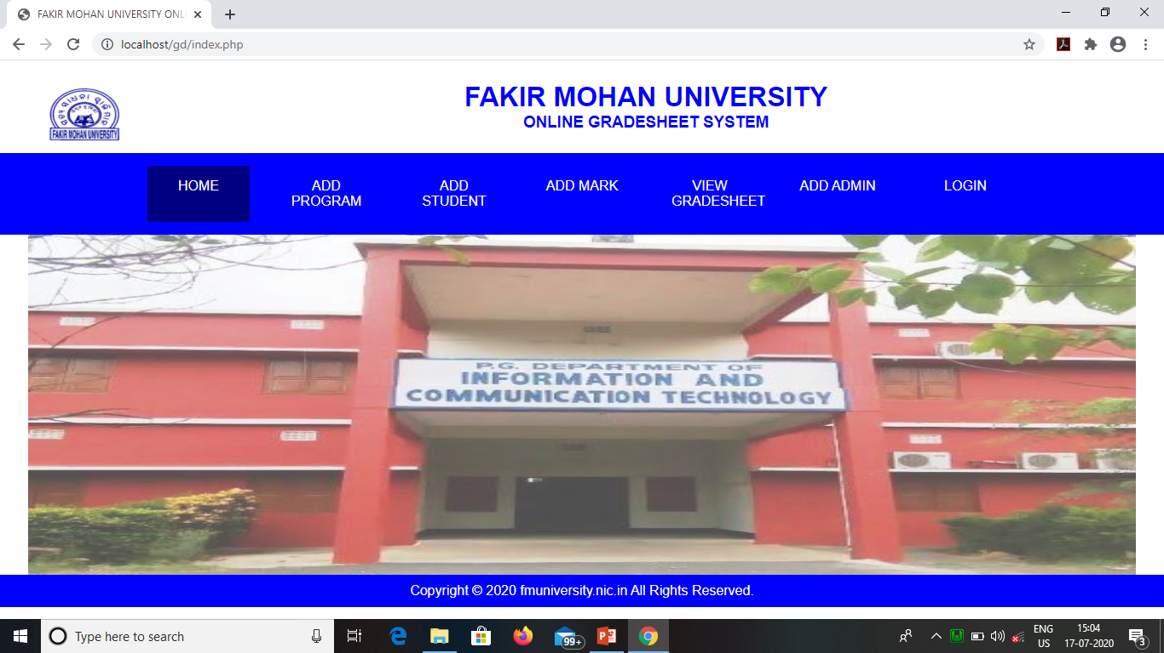
INDEX

Slide 13
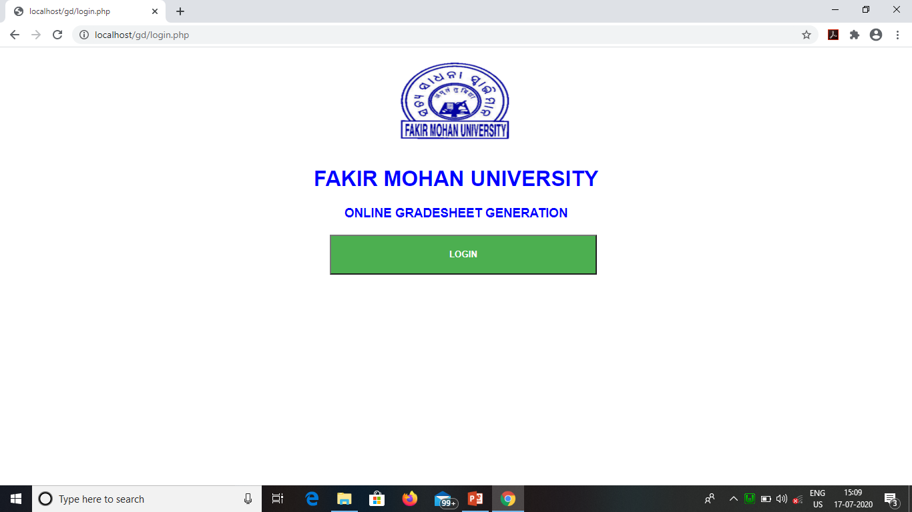
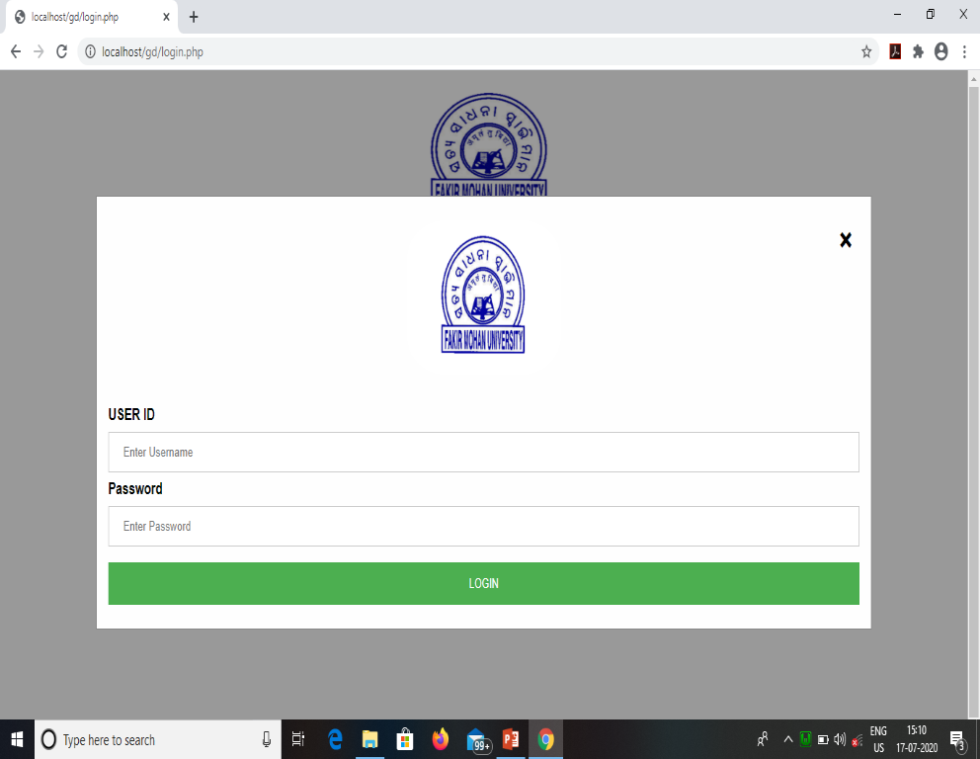
Login Page

Slide 14
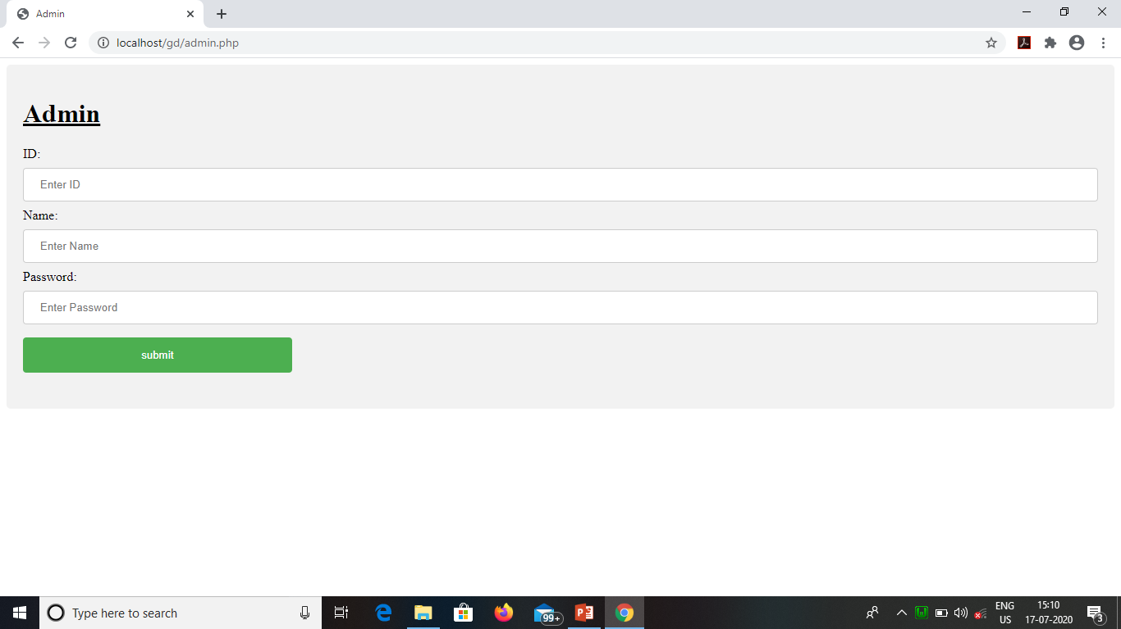
ADMIN HOMEPAGE

Slide 15
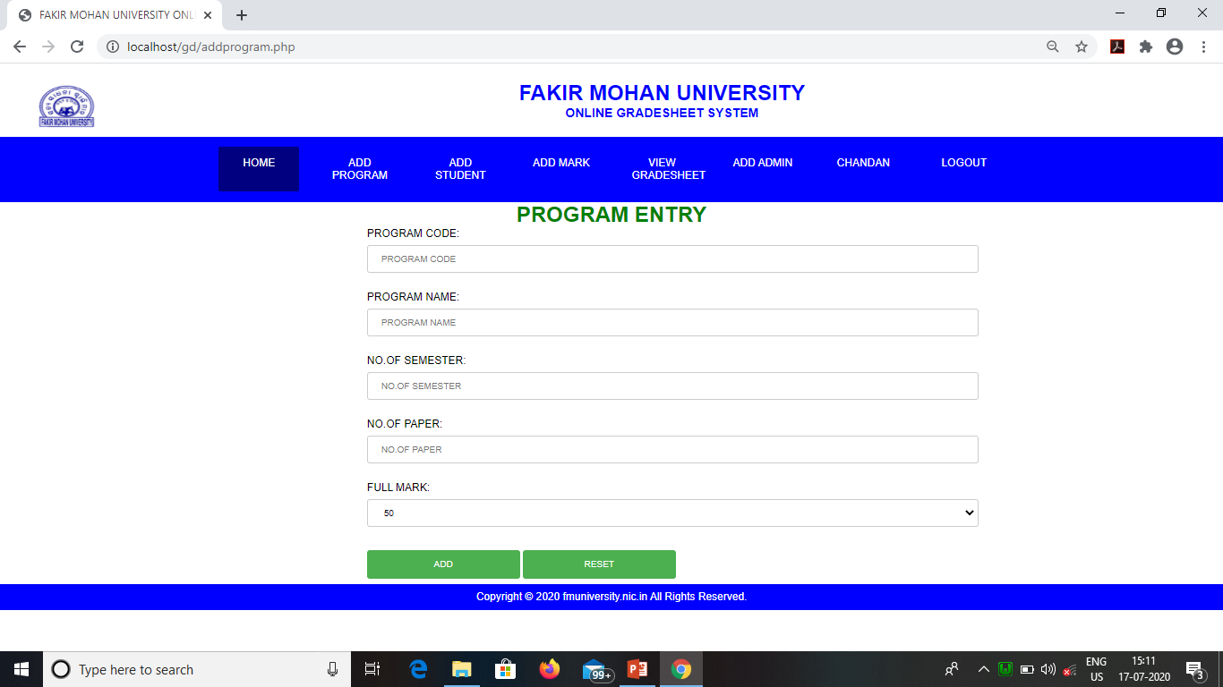
ADD PROGRAM

Slide 16
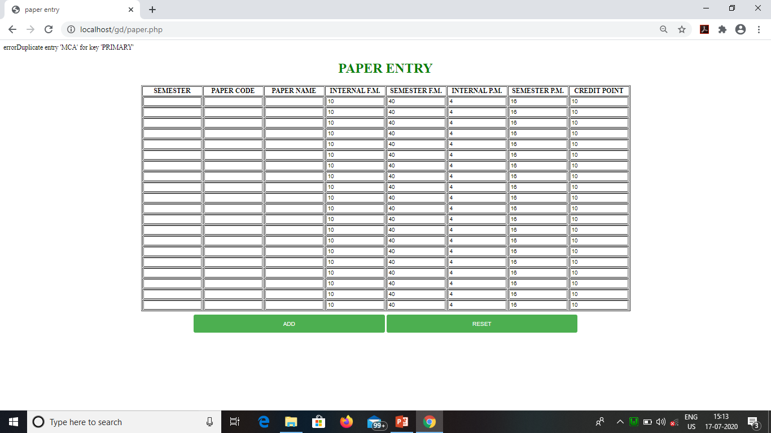
ADD PAPER

Slide 17
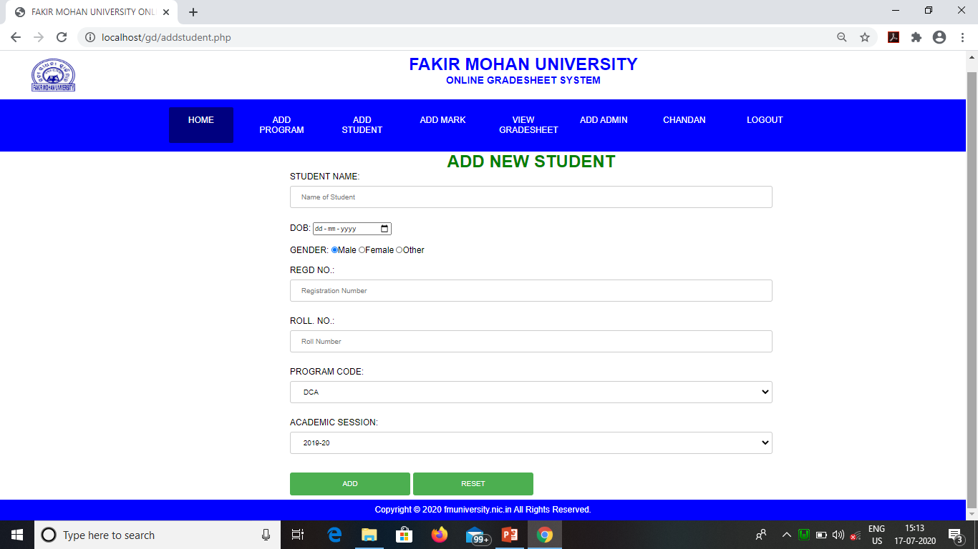
ADD STUDENT

Slide 18
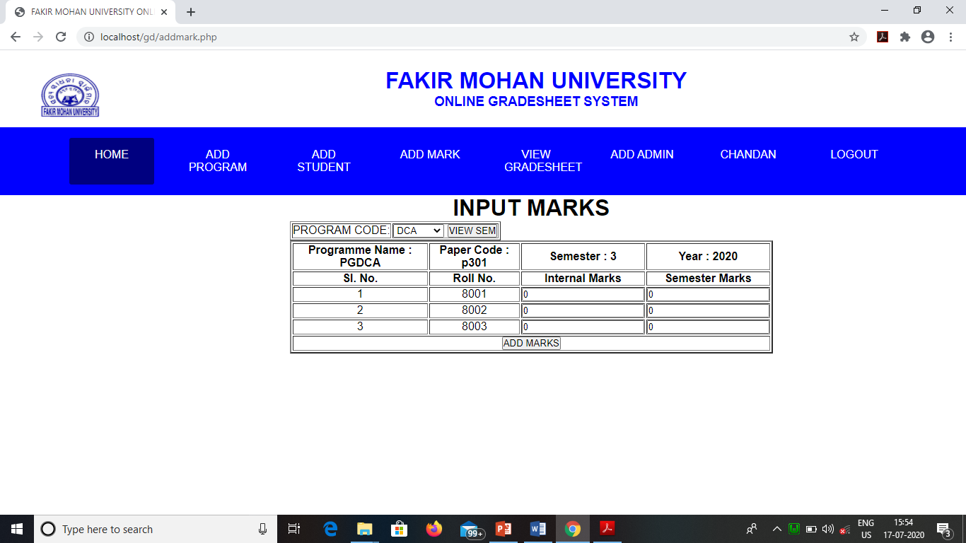
Mark Input

Slide 19
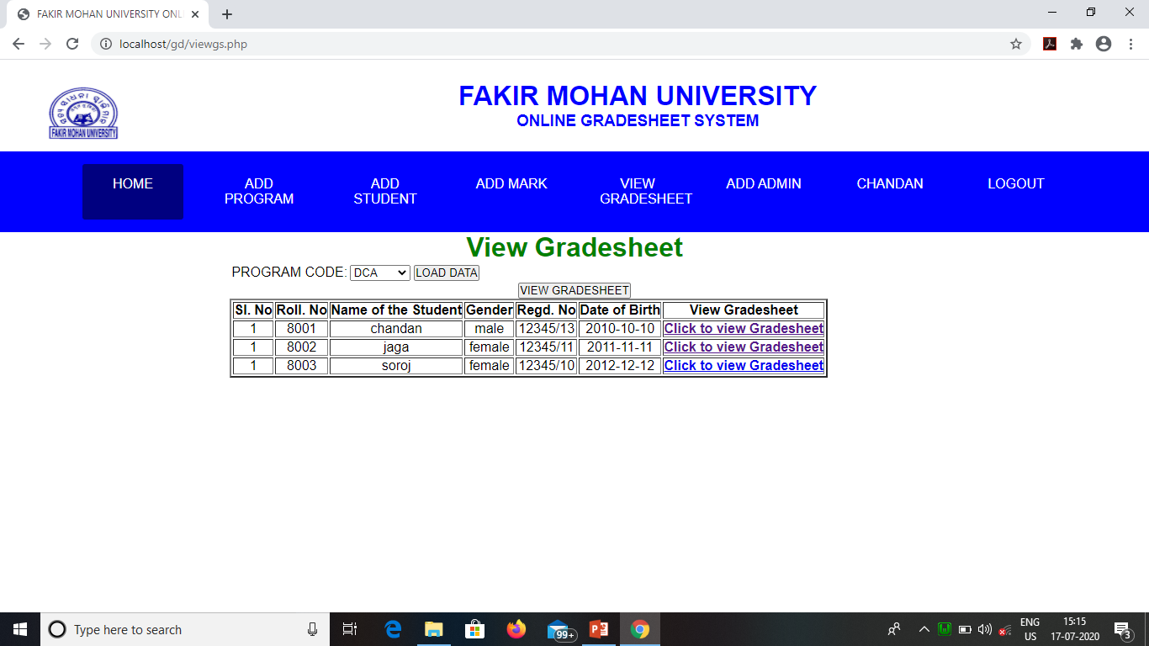
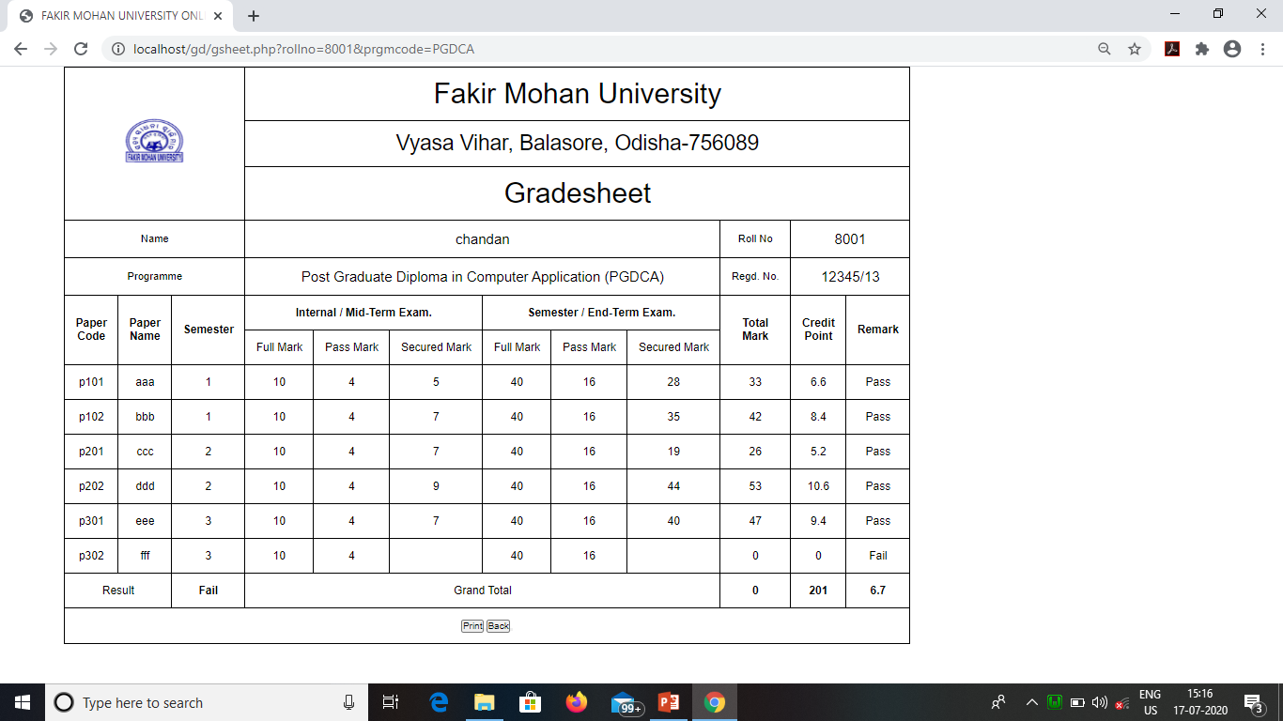
VIEW GRADESHEET

Slide 20


